Slide 1
ENVIRONMENTAL ISSUES IN ESTATE ADMINISTRATION

Slide 2
TOPICS
Contaminated Sites
Mineral Interests
Renewable Energy Projects
Example of Certificate of Title

Slide 3
Contaminated sites
The Environmental Management Protection Act, 2010
Reporting duties
Transfer of responsibility for environmentally impacted sites
Environmentally impacted sites registry

Slide 4
Contaminated sites
Reporting Duties
The EMPA does not refer to trustees or executors specifically, but prescribes duties for “owners”
An owner is required to report release and/or discovery of substances that are causing or may cause an adverse effect
The Minister of Environment can issue an EPO against a “person responsible” if the person is doing anything or carrying out any activity that “may cause or is causing an adverse effect”

Slide 5
Contaminated sites
Transfer of Responsibility
To transfer responsibility of an environmentally impacted site, the transferee must accept full responsibility for any environmental issues identified in the site assessment
Agreement to accept responsibility for an environmentally impacted site must include a corrective action plan
The person accepting responsibility must forward a copy of the agreement to the Minister of the Environment within 30 days

Slide 6
Contaminated sites
Environmentally Impacted Sites Registry
The EMPA provides for an environmentally impacted sites registry, however it has not yet been implemented in Saskatchewan
It is possible to search for spills that occurred from January 1, 1998 to present at: http://environment.gov.sk.ca/saskspills/spills_srch.asp
Spill information may also be obtained through an access to information request

Slide 7
Mineral rights
Mineral Leases
Provide that payments are made to the owner of the property in accordance with the terms and conditions of the mineral lease
Define access to the property
May address obligations related to the land after operations are completed
Executor’s power to enter into a mineral lease may be subject to directions in the Will

Slide 8
Mineral rights
Transfer of Mineral Rights
Separate surface and subsurface titles are issued
A subsurface title must not reference more than one mineral parcel
Mineral titles may be transferred separately

Slide 9
Mineral rights
Oil and Gas Leases
In Saskatchewan an oil and gas lease is not a “lease” within the meaning of The Administration of Estates Act, meaning a personal representative can lease for a term of longer than one year with the approval of the court
Beneficiaries may receive royalties and rental payments when the land is subject to an oil and gas lease
Interests in the land must be registered on title

Slide 10
Mineral rights
The Oil and Gas Conservation Act – Operations
Definition of “licensee” includes a trustee
Wells and facilities cannot be owned and operated without a licence held in the owner’s name
Licensee must apply for a transfer of licence within 14 days of signing an agreement

Slide 11
Mineral rights
Oil and Gas Conservation Act – Abandonment
The licensee is responsible for the costs of abandonment and reclamation of a well, facility, or associated flowline
Abandonment does not relieve the licensee of the responsibility for the costs of undertaking further abandonment or reclamation work

Slide 12
Mineral Rights
Operator Bankruptcy – The Redwater Case
Orphan Well Association v Grant Thornton Ltd., 2019 SCC 5
Supreme Court decision on the interaction between bankruptcy law and provincially imposed environmental obligations with respect to abandonment and remediation of “end of life” oil wells
The Court concluded that a trustee in bankruptcy cannot simply walk away from the environmental liabilities of the bankrupt’s estate
Trustees are protected from personal liability under the BIA, but the liability of the bankrupt’s estate under provincial legislation is ongoing
In this case, Alberta legislation required GTL to expend estate assets on carrying out abandonment obligations on Redwater’s spent wells

Slide 13
Mineral rights
Oil and Gas – Operator Bankruptcy
End of life responsibilities may include:
Plugging and capping oil wells
Dismantling surface structures
Restoring surface condition

Slide 14
Mineral rights
Potash
Under a potash lease, the lessee generally pays royalties and taxes
Possible conflicts between oil and gas production and potash production

Slide 15
Renewable energy
Wind and Solar Power
As with mineral rights, renewable energy rights in private land are typically acquired by lease
Leases may include easements such as:
Rights of access, ingress, and egress
Rights to commit nuisance
Rights to construct and maintain electrical transmission facilities

Slide 16
Renewable energy
Wind and Solar Power
SaskPower purchases the electricity generated through renewable energy projects throughout Saskatchewan
Typical lease provisions:
Lease and royalty payments to owner
Payments may be per installed megawatt or percentage of electricity produced
Lessee may have exclusive right to lease the property or portion thereof
Provisions for termination

Slide 17
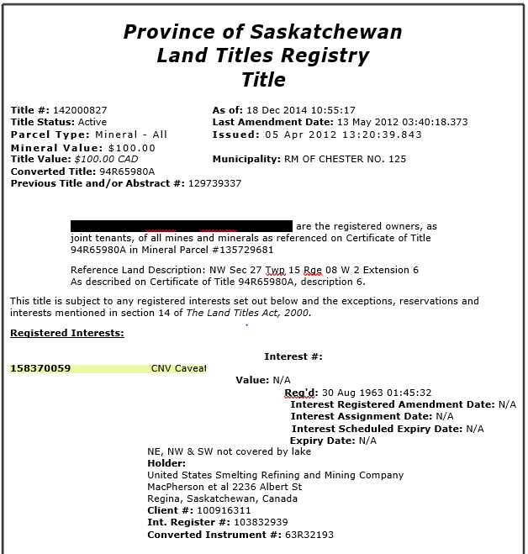
Certificate of title

Slide 18
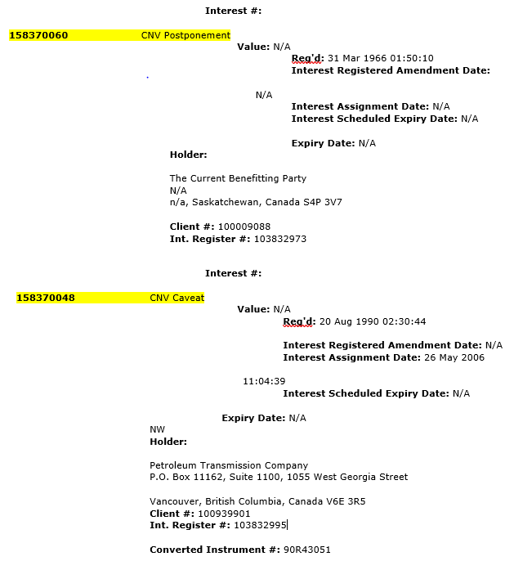
Certificate of title

Slide 19
Q&A

Slide 20
Thank you
Chad Eggerman
T: (306) 956-2175
F: (204) 975-7145
ceggerman@mltaikins.com
“MLT Aikins” the MLT Aikins Designs and “Western Canada’s Law Firm” are trademarks of MLT Aikins LLP. Copyright © 2017 MLT Aikins LLP. All rights reserved.
Note: This presentation is of a general nature only and is not exhaustive of all possible legal rights or remedies. In addition, laws may change over time and should be interpreted only in the context of particular circumstances such that these materials are not intended to be relied upon or taken as legal advice or opinion. Readers/viewers should consult a legal professional for specific advice in any particular situation.

