Slide 1
What’s new at the information and privacy commissioner
CBA, Privacy Sector, Saskatoon, SK
Information Sharing and Privacy: Practice and Alignment
October 7, 2019
Ronald J. Kruzeniski, Q.C.
SK Information and Privacy Commissioner

Slide 2
The Data Matching Agreements Act
Passed March 2018
To be proclaimed
Justice working on regulations
Initiating party
Participating party
Agreement before project begins

Slide 3
The Interpersonal Violence Disclosure Protocol (Clare’s law) Act
Bill 141, Passed May 2019 - To be proclaimed
Protocol – regulations
Section 9

Slide 4
The Privacy Amendment Act, 2017
Chapter P-24 - Passed March 2018
It is a tort to distribute an intimate image
- Without that person’s consent
- Claim for damages, profits or injunction
- See sections 7.1 to 7.8

Slide 5
The Sask. Employment (leaves) Amendment Act
Amendments below passed May 2019
New section 2-56.1 Interpersonal violence and sexual violence leave
Leave up to 10 days in 52 weeks
An employee must maintain confidentially ss2-56.1(5) and (6)
Strict confidentiality and disclosure provision

Slide 6
THE WORKERS’ COMPENSATION Amendment Act, 2018
Passed May 2019 – not yet proclaimed
Section 23 of FOIP – (1) FOIP prevails – (2) listed sections of Acts prevail
Sections 172-174 of WCA – listed
Removed from list
FOIP applicable

Slide 7
Victims of homicide
LA FOIP January 1, 2019
Police forces covered
Issue – naming of victims of homicide
Case by case determination
Clarification regulation amendment – February 2019
Police Chief may:
- 10.2 …. a police service or regional police service as defined in The Police Act, 1990 may disclose to the public the name of a deceased person if the person’s death is being investigated as a homicide by the police service or regional police service.

Slide 8
Police Scanners
Changing technology – analog to digital
History – media had scanners
Radio transmissions containing personal information
Now police not giving access
Providing information in alternate ways

Slide 9
Solicitor-client privilege
University of Saskatchewan v Saskatchewan (Information and Privacy Commissioner), 2018 SKCA 34 (CanLII)
Choice:
- provide my office the documents
- provide the documents redacted
- provide an affidavit and schedule
Rules of Procedure - Part 9- Form B
Litigation Privilege

Slide 10
Humboldt broncos
8 involved:
1 office manager
7 physicians
380 breach events
6 Reports
Used names in version to trustees
Used initial for web version
Interim injunction – no notice
Interlocutory injunction
Injunction not continued – Justice Danyliuk
March 29, 2019
Stebner v Canadian Broadcasting Corporation, 2019 SKQB 91 (CanLII)
Result, some regulation amendments

Slide 11
Circle of care
Many said circle of care
Principle, need to know

Slide 12
Need to know
From the Danyliuk decision
[46] Need to know is not a construct of the IPC. It comes from s. 23 RIPA:
23(1) A trustee shall collect, use or disclose only the personal health information that is reasonably necessary for the purpose for which it is being collected, used or disclosed.
(2) A trustee must establish policies and procedures to restrict access by the trustee's employees to an individual's personal health information that is not required by the employee to carry out the purpose for which the information was collected or to carry out a purpose authorized pursuant to this Act.

Slide 13
Need to Know
[47] Section 23 imposes two related duties on a trustee of private medical information, such as SHA:
First, data minimization. SHA is to strive to collect, use and/or disclose the least amount of private medical information required to carry out the purpose behind that information. In SRA's case, this purpose is generally the delivery of health care.
Second, need to know. SHA, as a trustee, must set up its information system so that patients' private medical information is only available to its employees having a legitimate need to know that information for the purpose of delivering medical care services to that patient.

Slide 14
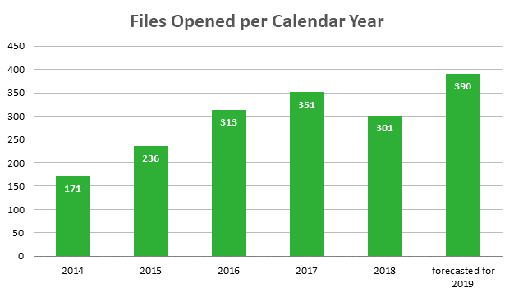
Workload
*Year to date 50% increase over 2018

Slide 15
The Last 5 years
Format of Reports
Rules of Procedure
Exemptions guide
existing version
New version
A must read
Called a guide

Slide 16
The Next 5 years
Modernize the legislation
- FOIP and LA FOIP
- HIPA
Regulations
Annual Report https://oipc.sk.ca/about/annual-reports-and-financial-statements/

Slide 17
The Next 5 Years

Slide 18
Modernizing the legislation
FOIP Part 4 – Privacy Protection
Apply to political parties – organization receiving grants
Organization spending tax dollars
Business?
PIPEDA – Federally probably amended
Alberta, BC
Provincial Legislation
Ontario may be considering

Slide 19
The Next 5 years
Respectful and helpful
Advice
1200 calls per year
Advice on procedure
Advice on what to send us
Won’t always agree
Done in a respectful and helpful way

Slide 20
Questions?
Saskatchewan Information and Privacy Commissioner 503 – 1801 Hamilton Street Regina SK S4P 4B4
Telephone: 306-787-8350 Toll Free Telephone (within Saskatchewan): 1-877-748-2298 Fax: 306-798-1603
Email: webmaster@oipc.sk.ca
Website: www.oipc.sk.ca Follow us on Twitter: @SaskIPC

