Slide 1
Do you have study permit issues?
Round Table Discussion Regarding
the Approval of Study Permits
DAVIDA L. BENTHEM VEEMAN LAW

Slide 2
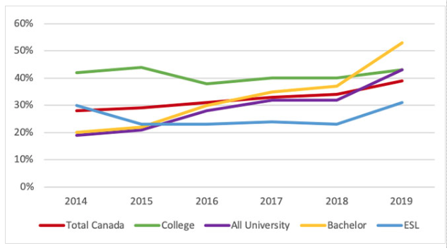
Rejection rates of study permits 2014-2019

Slide 3
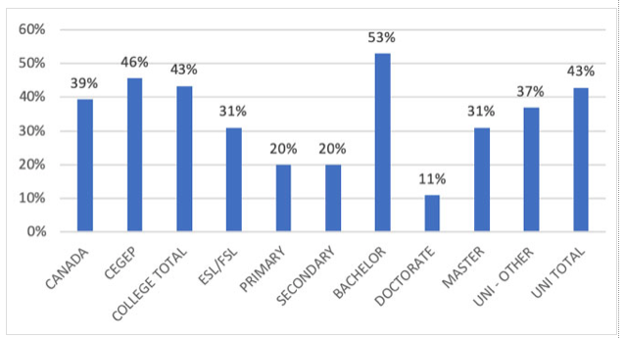
First 5 months of 2019, 51% of applicants for Bachelor degrees refused

Slide 4
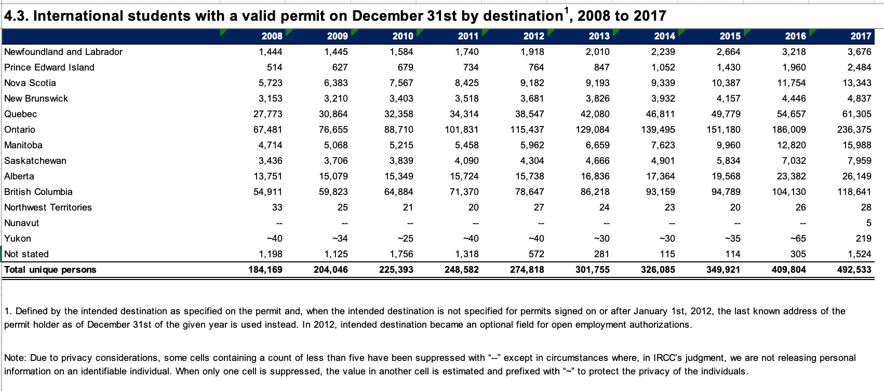

Slide 5
How to make a study permit application stand out
Purpose of study letter
Funds
$10,000 plus tuition (plus $4000 for spouse, plus $3000 per child)
Preferably full amount accessible at time of application
I have seen success showing tuition in a bank account and stipend letters to cover the $10,000 for graduate level
Preferably in the applicants account
Unconditional acceptance letter
Be 18 years plus or have a custodian
Address Temporary Intent
Family ties
Assets/ funds
Job prospects in home country upon degree completion

Slide 6
Student Direct Streams
Be a legal resident and live in: China, India, Morocco, Pakistan, Philippines, Senegal or Vietnam
Added requirements
10,000 Can GIC and paid 1st year tuition fees
Upfront medical (if required)
Police Certificate (if required)
IELTS 6 +
Benefit – faster processing time for applicant and family (20 days)

Slide 7
Reason Study Permits may be Refused
Funds not in applicants name
Difficulty showing temporary intent when student is already studying abroad and applying from that country
”older” applicants
Applying for a study program not inline with area of work or previous studies
Applying for a degree type the applicant already has
Coming from certain developing countries or countries currently in turmoil (eg Cameroon, Zimbabwe, Ukraine)
Others?

Slide 8
Things not to forget
Country specific requirements (eg. proof of language ability, medicals, police certificates, etc.)
Is a work permit a requirement of the program of study? Then apply for a co-op work permit as well

Slide 9
Study Permit: Assessing Study Permit Conditions
IRPR 220.1(1) A study permit holder shall enroll at a DLI and remain enrolled until they complete there studies AND they shall actively pursue there course or program of study
Mid-2019 definitions and policy came out as to what this exactly means
150 days is the golden rule
Leave from studies must be less than 150 days AND approved by DLI
Poses continuing challenge for DLIs:
eg. UofS Grad students have enrollment status of academic leave but UG students still do not
UofS Language Centre Confirmation of Enrollment reflects PT studies when they are indeed FT

